Slide 1
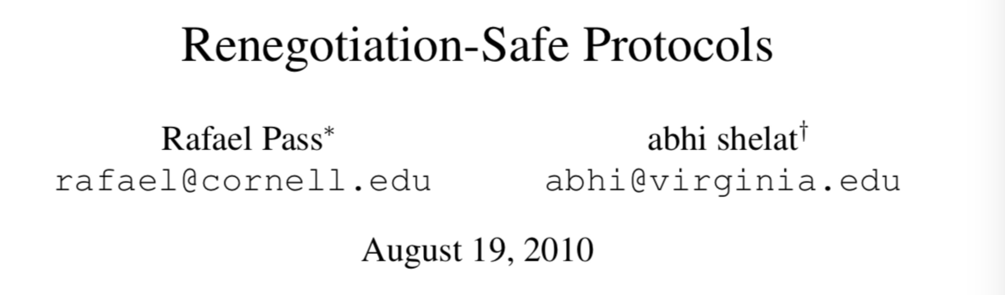

Slide 2
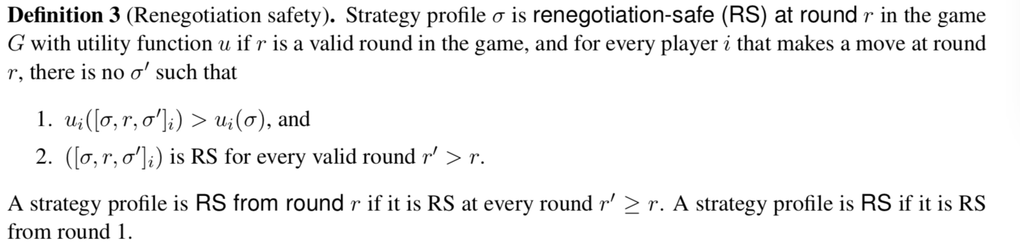
Definition of Renegotiation-safe
We assume that only one player makes a move at every round.

Slide 3
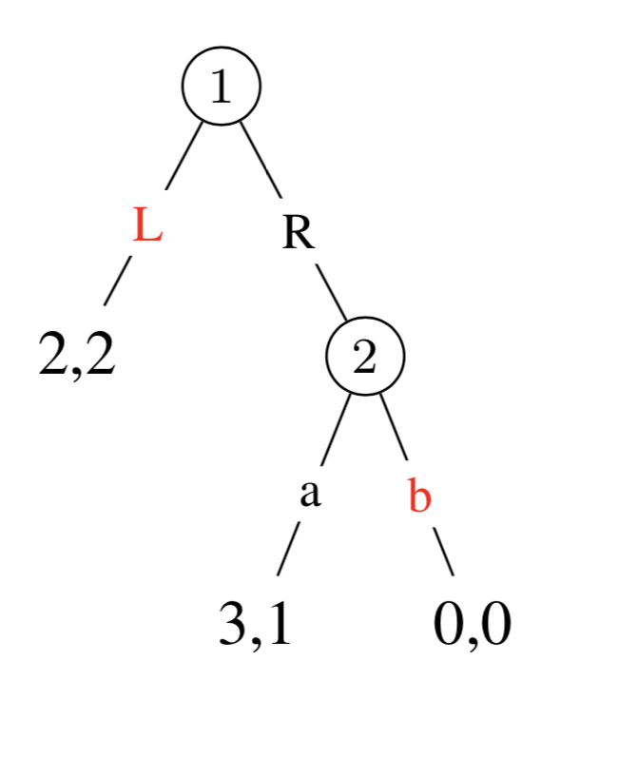
Example of Renegotiation-safe
In this game, [L, b] is not a renegotiation-safe strategy. The first player can renegotiate to (R, a).
If we change the utility of [R, b] to (0,3), then [L, b] is a renegotiation-safe strategy.

Slide 4
We want to find the relations among RS, NE and SPE.

Slide 5
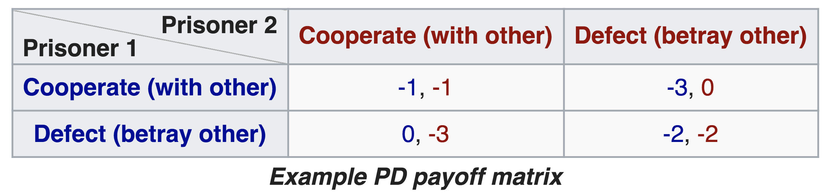
Nash Equilibrium
Two or more players in which each player is assumed to know the equilibrium strategies of the other players, and no player has anything to gain by changing only their own strategy.
Only NE in pure strategy.

Slide 6
Subgame Perfect Equilibrium
A strategy profile is a subgame perfect equilibrium if it represents a Nash equilibrium of every subgame of the original game.
Subgame:
After any history h has reached, the remains in the game.
(Dp, TL) is a SPE strategy.

Slide 7

NE, but not SPE nor RS

Slide 8
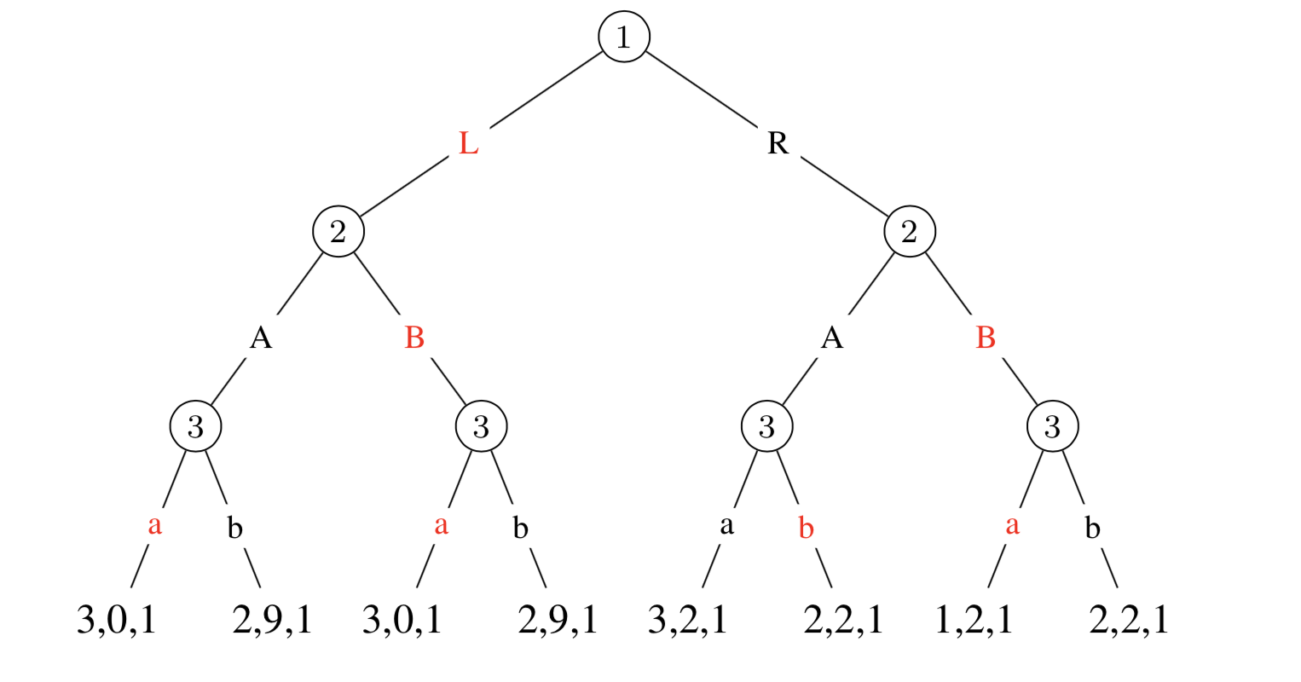
SPE but not RS
(L, (B, B), (a, a, b, a)) is not RS. At round 2, player 2 can renegotiate to (L, (A,.), (b,…)).
(R, (A, A), (a, a, a, a)) is RS and SPE.

Slide 9
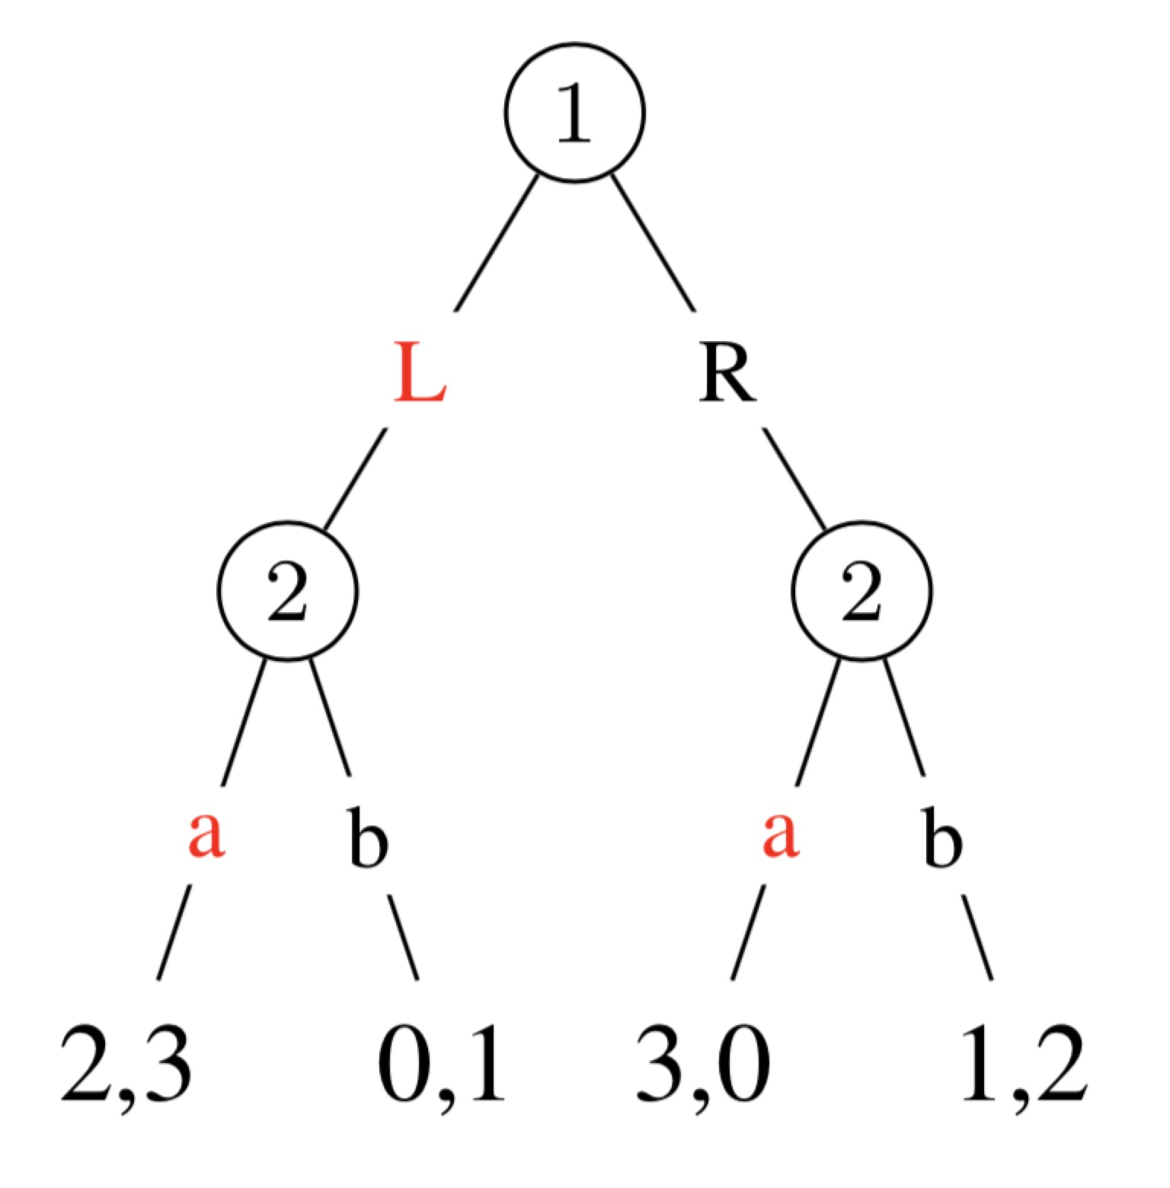
RS but not NE
(L, (a, a)) is a RS but is not NE.
(L, (a, b)) is both NE and RS.

Slide 10
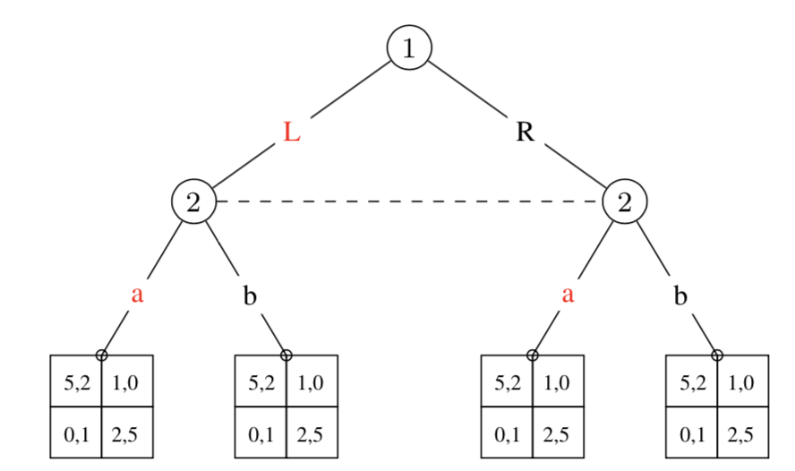
SPE but not RS
Game G′. In the first round, players move simultaneously and announce cheap-talk messages. In the second round, they play a normal form game G.

